Slide 1
Applying to US Residency Programs
Yashas Nathani
Assistant Professor
Pediatric Emergency Medicine
Children’s Hospital of Oklahoma

Slide 2
My Story
Canadian citizen
Graduated from American University of Antigua – College of Medicine → May 2014
Pediatrics Residency – St. Peter’s University Hospital, NJ → 2014-2017
  J1 Visa
Pediatric Emergency Medicine Fellowship – University of Oklahoma, OK → 2017-2020
  J1 Visa + Couples Match
Attending Physician → July 2020
  J1 Waiver (H1B)

Slide 3
Steps
1. ECFMG - The Educational Commission for Foreign Medical Graduates
  Assesses whether IMGs are ready to enter ACGME-accredited training programs in the US
  Must be certified by ECFMG before USMLEs/Residency
  www.ecfmg.org
2. USMLE
  Step 1, Step 2 CK, Step 2 CS*
  Time sensitive
  Meet exam requirements (in or after medical school)
  www.usmle.org

Slide 4
Steps
3. Medical Education Credentialing Requirements
  Medical school and graduation year are listed in the World Directory of Medical Schools
  Awarded credit for at least 4 credit years of medical school
  Documentation for completion of all credits & receipt of a final medical diploma
  Final medical school transcripts

Slide 5
Steps
4. Applying to US Graduate Medical Education Programs
  Identify the field of medicine of interest
  Review state-specific requirements (https://www.fsmb.org/advocacy/)
  Review residency programs + requirements (https://www.ama-assn.org/residents-students/match/freida)
  Complete and submit application through ERAS - Electronic Residency Service Application (https://www.ecfmg.org/eras/)
  Register with NRMP and submit Rank Order List

Slide 6
Timeline
Ensure that your medical school is recognized by ECFMG prior/early during medical school
USMLE Step 1 after 2nd year medical school
  Pass/Fail
USMLE Step 2 CK during 3rd year medical school
  Average 246, passing 214
USMLE Step 2 CS – end of 3rd year medical school (Before July)
**USMLE Step 3
ERAS – September
Interviews – September – January
Rank Order List – End of Jan/Feb
Match Day – Mid March

Slide 7
Tips
Set up Timeline
Identify Mentors
Step Scores/Number of Attempts MATTER
Set up electives in the US (end of 3rd year, beginning of 4th year)
  Audition Electives (free vs. paid)
Identify the right people and ask for Letters of Recommendation
Personal statement – edit
Prepare for Interviews**

Slide 8
Applications
Submit on time!
Make sure the application is complete
FOLLOW UP (Phone>email>voicemail)
Prepare for your interview
  Practice speaking in a formal setting
  Zoom/Skype etiquette
  Ask appropriate questions (vs. generic)
Thank you emails
2nd look
Follow up before Rank Order List

Slide 9
J1 vs. H1B
J1 – Exchange Visitor Visa
  Need Statement of Need (SON) from Health Canada stating that there is a need for your specialty, but is unable to provide you with training, and is therefore agreeing to send you to the US; intend to come back and work in Canada after training
  Cannot have extra income during residency (No Moonlighting)
H1B – Work Visa
  Not subject to lottery (vs. other professions requiring H1B)
  + Moonlighting
  Need to pass Step 3 prior to starting residency

Slide 10
J1 vs. H1B
More hospitals willing to sponsor J1 (H1B requires ~$10K and immigration attorney; hospital’s expense)
More fellowship opportunities with J1
Subject to J1 waiver if you want to stay on in the US after training
  Work in an underserved area x 3 years, 160 hrs/month
  Designed for Primary care
  Limited opportunities, especially for specialists
  Upon completion, eligible for Green Card application

Slide 11
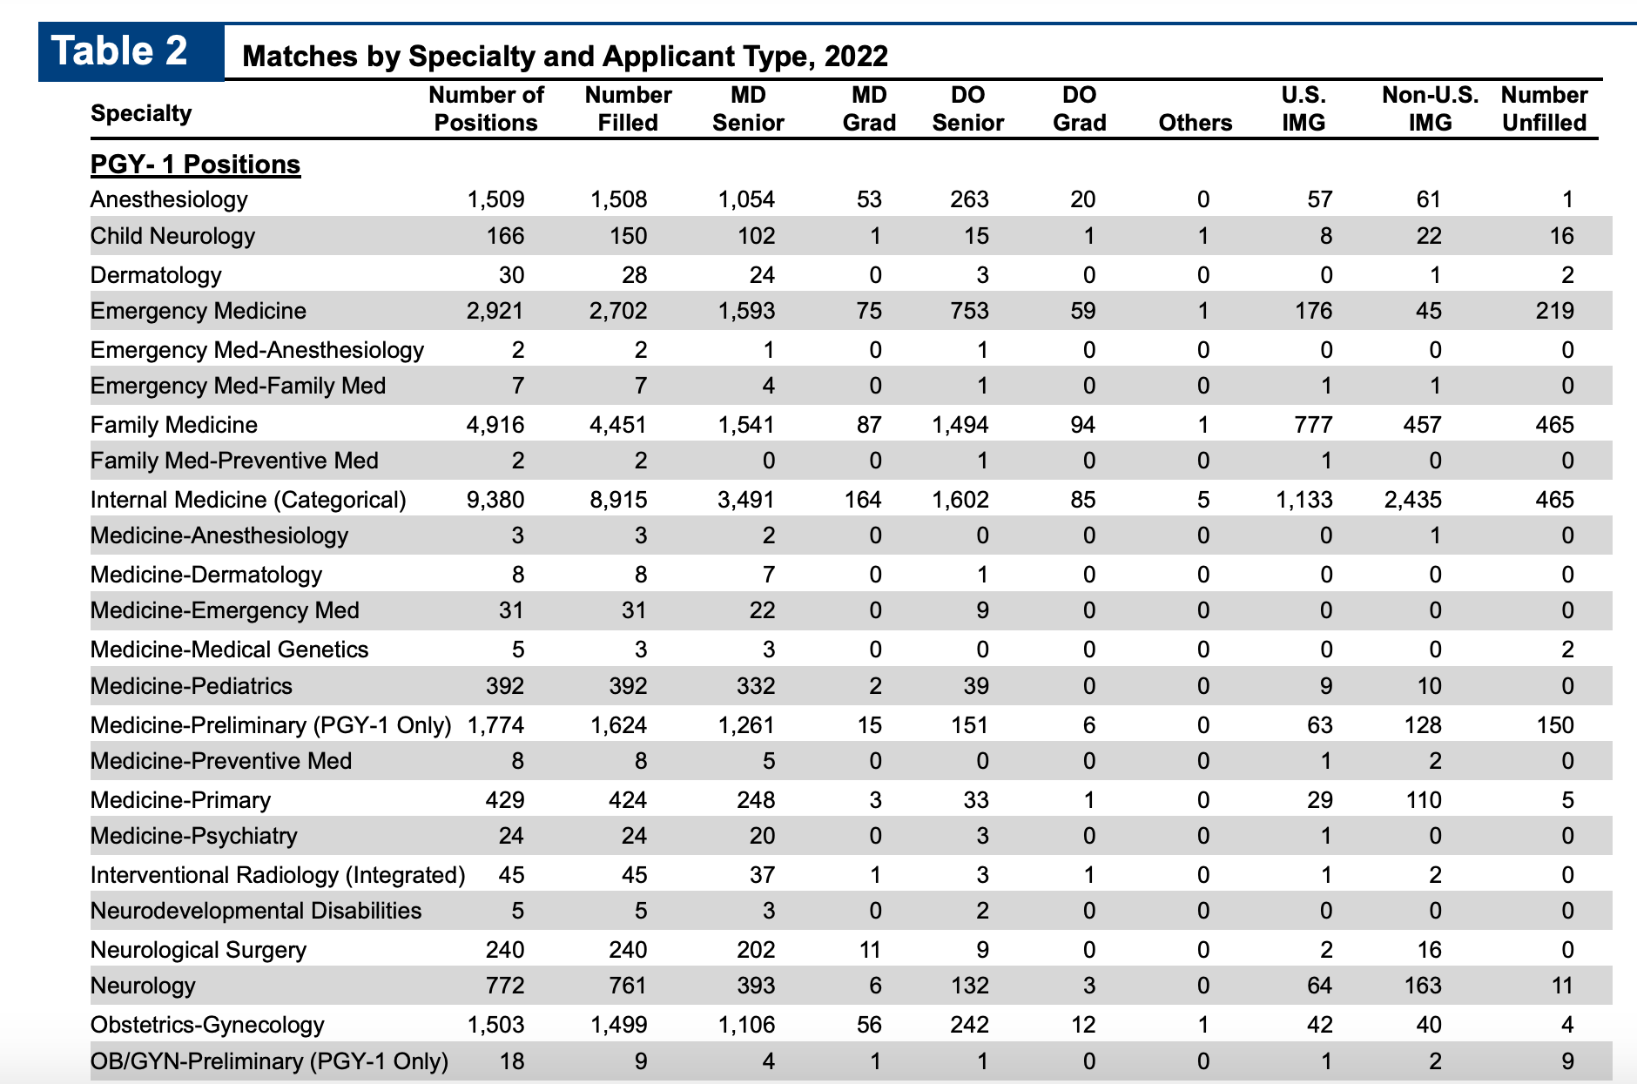
Residency Match Outcomes

Slide 12
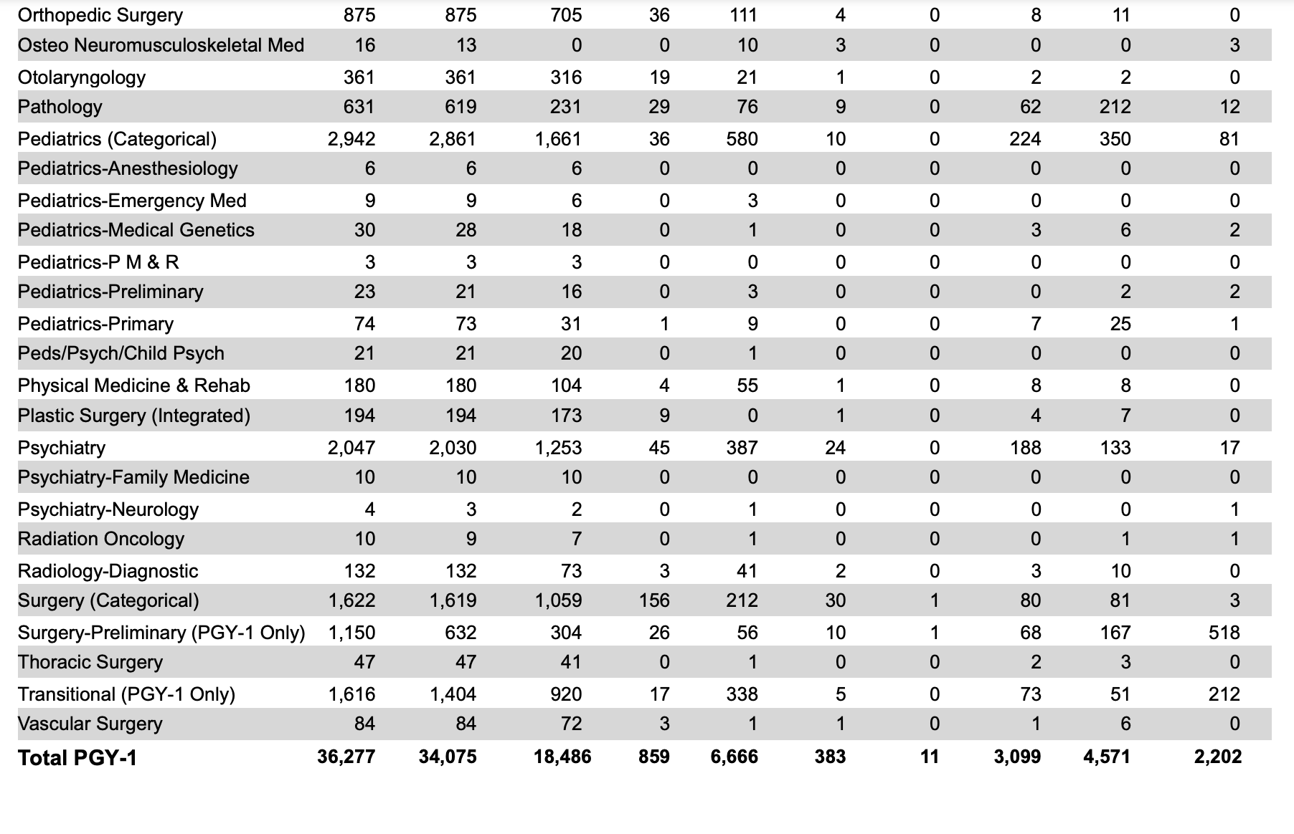

Slide 13


Slide 14
Nathani.yashas@gmail.com

