Slide 1
Society of Canadians Studying Medicine Abroad
Email: socasma@outlook.com
Mail: 22879-29B Avenue, Langley, BC V2Z 3B1
Website: socasma.com
Facebook: Society of Canadians Studying Medicine Abroad

Slide 2
Acronyms
SOCASMA—Society of Canadians Studying Medicine Abroad
SONs—Statements of Needs
ROS—return of service contract
CMG—Canadian medical school graduate
  Graduates from Canadian medical schools
  Graduates from American LCME accredited medical schools
CSA—Canadians studying medicine abroad (Us)
IMG—International Medical graduates
  Canadians studying medicine abroad (people who were born/and or raised in Canada and choose to study medicine abroad)
  Immigrant physicians (physicians who were educated and trained as physicians in their home country, immigrated to Canada, and now seek to qualify to practice in Canada. This is distinct from foreign physicians who are recruited for the specific purpose of coming to Canada from a country whose training is recognized in Canada for the purpose of meeting the doctor shortage in Canada.)

Slide 3
Acronyms
CaRMS—Canadian Resident Matching Service
USMLEs—United States Medical Licensing Exams

Slide 4
PURPOSE OF THE SOCIETY OF CANADIANS STUDYING MEDICINE ABROAD (SOCASMA)
Student Support.
Information on website—socasma.com
  Some can only be accessed by members
Facebook page—Society of Canadians Studying Medicine Abroad
Email—socasma@outlook.com
Change the current system that discriminates against international medical graduates via legal action.
Improve access to Canadian residency training.
Fight to retain access to American residency training.

Slide 5
Ultimate Goal for Medical Students -
Obtain a Residency!
You cannot practice medicine without a residency!
Residencies are also known as Post Graduate Medical Education
Residency programs in Canada are provided by the seventeen Canadian Universities offering training in medicine
These universities, in conjunction with the Provincial Governments, determine number and type of residency programs available and the entry criteria for residency that applicants must meet
The Association of Faculties of Medicine of Canada (AFMC) represents these Faculties of Medicine

Slide 6
CaRMS
CaRMS = Canadian Residency Matching Service
  CaRMS is the Canadian version of the U.S. National Residency Matching Program
CaRMS runs the Canadian residency matching process that takes applications for medical residency from prospective residents and matches them to available residency programs offered by the Canadian faculties of medicine based on a matching algorithm and applicant and faculty rankings
CaRMS eligibility criteria are set by the Provinces and the AFMC

Slide 7
CaRMS Dual Stream Process
The eligibility criteria set by the Provinces and AFMC divide applicants into two streams
Canadian Medical Graduates (CMGs), including United States Medical Graduates (USMGs), who graduated from schools approved by the Liaison Committee on Medical Education (LCME) all apply to one stream
All other applicants are considered International Medical Graduates (IMGs), including Canadians Studying Abroad (CSAs)

Slide 8
Two “Iterations”
The R1 or CaRMS main match has two steps or stages called “iterations”
In the first iteration, CaRMS uses a “dual stream” approach where IMGs compete in a separate matching process from CMGs and USMGs
The second iteration is normally competitive where IMGs, CMGs and USMGs all compete for the remaining positions left after the first iteration
Recently, however, Provincial governments and AFMC have been designating many of these positions only for CMGs who did not match in the first iteration

Slide 9
Eligibility for the Match
While each Province technically sets their own eligibility criteria, most provinces set very similar criteria (check your individual province for their specific eligibility criteria)
IMGs are subject to a variety of eligibility criteria that CMGs and USMGs are not:

Slide 10
Eligibility for the Match
IMGs must write the Medical Council of Canada Qualifying Exam 1 (MCCQE1) in order to apply to CaRMS for residency
To meet time lines for the CaRMS application, IMGs must write the MCCQE1 around the end of their third year of medical school
CMGs must write the MCCQE1 exam before starting residency, but do not need to write it to apply to CaRMS
Most CMGs write the MCCQE1 at the end of their fourth year with more knowledge than IMGs have at the end of their third year
This makes comparison between scores for CMGs and IMGs impossible

Slide 11
Eligibility for the Match
IMGs must complete the National Assessment Collaboration Objective Structured Clinical Examination (NAC) to be eligible to apply to the CaRMS Match
CMGs and USMGs are not required to complete this exam

Slide 12
Return of Service Agreements
Most, if not all, Provinces require IMGs to sign a Return of Service Agreement, typically 2 to 5 years, if they are accepted into a residency program in that province
Further Return of Service Agreements may be required for Post Residency Fellowship training
CMGs are not required to agree to a Return of Service Agreement (ROS) despite having their entire education funded by taxpayers while IMGs have funded their own education

Slide 13
Statistics for the Dual Stream System
In the 2019 match, CMGs had 3,020 positions available for 2,934 applicants, 97.7% of CMGs matched to a residency and only 31 CMGs were unmatched
In the 2019 match, IMGs had only 326 positions available for over 2,200 applicants, only 17% of IMGs were successful in matching, and 1,911 IMGs were unmatched!

Slide 14
Statistical Trends
It’s Getting Worse
In the 2013 CaRMS match, just 6 years ago, 499 IMGs matched for a 22% match rate, vs just 326 for a 17% match rate in 2019

Slide 15
Other issues: Choice of Specialties
CMGs can apply to any specialty in the 2019 match, first iteration, 45% of positions were in Family Medicine, leaving 65% of positions for other specialties
In the 2019 match, , first iteration, 66% of positions available to IMGs were in Family Medicine, leaving only 34% of positions for other specialties. Most specialties have only 2 to 3 positions available for IMGs all across Canada

Slide 16
Why be concerned?
You can’t be a doctor without residency
Dual stream process that disadvantages IMGs is contrary to most fundamental values of Canadian society
For the Health Care System, protection of CMGs ensures mediocrity, not excellence
Situation is getting worse

Slide 17
Values and Human Rights
In Ontario and several other Provinces, entry to practice is governed by the Fair Access to Regulated Professions and Compulsory Trades Act and overseen by the Office of the Fairness Commissioner
Legislation requires that entry to practice be:
  Fair
  Objective
  Impartial
  Transparent

Slide 18
Values and Human Rights
The current system is NOT:
  FAIR, because it treats two groups of Canadian citizens and permanent residents unequally based on where they attended medical school (in Canada or abroad).
    Also, IMGs must write exams like MCCQE1 and NAC that CMGs either don’t have to write, or must write these exams earlier than CMGs
    And, IMGs are required to agree to Return of Service contracts that CMGs are not required for CMGs
    Finally, IMGs have fewer opportunities to compete for residencies, and reduced access to specialties

Slide 19
Values and Human Rights
The current system is NOT:
  OBJECTIVE, because there is no objective basis for considering IMGs education inferior to CMGs to justify the current dual stream, many IMGs are graduates of highly regarded international medical schools
  The current system of evaluating IMGs through MCCQE1 and NAC is not equally applied to CMGs making any objective comparison between IMGs and CMGs, or even between CMGs, impossible

Slide 20
Values and Human Rights
The current system is NOT:
  IMPARTIAL, decisions regarding eligibility for applicants are being made by the Canadian Faculties of Medicine (AFMC) who have a vested interest in protecting and privileging their own CMG students
  AFMC representatives, as well as CMG student representatives sit on the CaRMS Board of Governors in numbers that dominate the Board
  Only representative of IMGs on CaRMS is a Board Appointed nominee, vs. a member elected by IMGS, so no true IMG representation on CaRMS
  CaRMS Board has refused request for CSA representation on three occasions

Slide 21
Values and Human Rights
The current system is NOT:
  TRANSPARENT, it is not clear how the various Provincial Ministries of Health and AFMC and the Provincial Faculties of Medicine set eligibility policies, there is no public input to these decisions, there appears to be no oversight of these decisions, and the rationale for these decisions is not clear or transparent. Finally, there are no public minutes or other means of documenting this decision making process.
  We have repeatedly tried to have various organizations including Council of Ontario Faculties of Medicine clarify where they derive the authority to set these policies, our requests for clarification have to date received no response.
  It is a legala principle that Governments should not be discriminating and benefiting or denying benefits to one group of Canadians over another without legislative authority. Where is that authority?

Slide 22
Values and Human Rights
Ontario Human Rights Policy on Removing the “Canadian Experience” Barrier:
  Current CaRMS eligibility process effectively creates a requirement for Canadian experience to apply for the majority of CaRMS residency positions, this is contrary to Human Rights legislation

Slide 23
Values and Human Rights
OntarioHuman Rights Policy on Removing the “Canadian Experience” Barrier states that:
  “Employers, representatives of employers and regulatory bodies should not:
  Require applicants to have prior work experience in Canada to be eligible for a particular job.
  Assume that an applicant will not succeed in a particular job because he or she lacks Canadian experience.
  Discount an applicant’s foreign work experience or assign it less weight than their Canadian work experience.
  Rely on subjective notions of “fit” when considering an applicant’s ability to succeed in the workplace.
  Include a requirement for prior Canadian work experience in the job posting or ad, or a requirement for qualifications that could only be obtained by working in Canada.
  Require applicants to disclose their country of origin or the location of their work experience on the job application form.
  Ask applicants questions that may directly or indirectly reveal where their work experience was obtained.
  Ask for local references only.”

Slide 24
Values and Human Rights
The current CaRMS eligibility and application process fails this test on virtually all points!

Slide 25
Where do we go from here?
Advocacy!
Letter writing to MPPs, Ministers of Health, other relevant organizations
More on this later!

Slide 26
Goal: Match to a Residency Position
Ultimately you need to impress and stand out.
Start by keeping all the doors open—Canada, US, country in which you studied.
Decide:
  Discipline; and
  First choice of school, province/state, and country.
Electives and rotations are important.
Research publications help impress.
Be aware of application criteria
Notes:
Time does not permit me to speak in detail about the strategies. Overview. Offer to send out PowerPoint. Sign up at the back. Will also answer questions .

Slide 27
Organization and Knowledge critical
Recognize that access to residency training is VERY challenging.
What are your options? Canada, USA, Australia, UK, or somewhere else.
Notes:
Timeline can be sent to you in Word

Slide 28
Timeline
Best to start familiarizing yourself with relevant information as soon as you start medical school.
What do you want to do? Is it available in your province? If not, where?
How do I get local connections where I want to be—formal electives? Privately arranged rotations?
What are the application requirements and timelines for electives?
What are the eligibility requirements for the provinces to which I want to apply (carms.ca—R-1 match—provincial eligibility)
When must I take the MCCQE Part 1? NAC OSCE? Specific provincial requirement?
Annotated Timeline developed by Socasma.
Warning: Timeline is a tool. Deadlines change all the time.

Slide 29
What you have to do.
See: St. George’s video on YouTube: https://www.youtube.com/watch?v=Rn1IWmRmgS0
#1 Meet the eligibility requirements
Canada. KNOW CARMS! https://www.carms.ca/match/r-1-main-residency-match/eligibility-criteria/
  Canadian citizenship or permanent resident status
  Substantial equivalency examinations—MCCQE Part 1 and NAC OSCE
  Language fluency examination if medical school is located in a country where the language of the public is not English
USA
  USMLEs https://www.usmle.org/
Country of Study
Notes:
People who do not match usually have put all their eggs in the Canada basket
Language requirement varies somewhat from province to province

Slide 30
What you have to do
#2 Address province specifics: PAY ATTENTION TO DETAIL
Each province has its own eligibility criteria
-Extra steps to verify degree
-Additional examinations
-Timing—No. of requirements are before the CaRMS application deadlines
Carms.ca: Provincial Eligibility Criteria https://www.carms.ca/match/r-1-main-residency-match/eligibility-criteria/
Notes:
Alberta—May 31 to apply to apply. Have to be a resident. Saskatchewan and Manitoba—CASPER. BC—CAP.
Ontario and Manitoba—segregation continues into second iteration now. The constant changes are difficult.

Slide 31
Do your homework. Do NOT assume.
Programs are different. Eg. Some will only consider IMGs who have done an elective in their school.
Many application deadlines. Not found in one place.
CaRMS deadlines different than provincial deadlines.
Must follow
  Deadlines for exams (mcc.ca; usmle.org)
  CaRMS eligibility requirements; application deadlines for CaRMS
  IMG Provincial websites—eligibility criteria; application deadlines

Slide 32
What you have to do
#3. Make yourself Stand Out
Know the criteria in the CaRMS Application early and start building
  the sooner the better: what you want to do, where you want to do it

Slide 33
Characteristics that correlate to successful match
Demonstrated Interest in the Field
Rotated in Canada (or US if seeking US match)
  54.6% did at least 1 elective in the province to which they matched
  32.% did at least 1 elective in the same university to which they matched
  47.0% did at least 1 elective in the same discipline to which they matched
Letters of Reference from Local Physicians
Good results in examinations
People knowing you is important—electives, research, observerships

Slide 34
Know what is in the application form
Know the CaRMS application headings so you can start building your application right away.
Personal Profile
  Letter introducing yourself (including why you are interested in the program)
  Languages
Notes:
US application very similar.

Slide 35
Know what is in the application form
Achievements and Interests
  Memberships, associations, committees
  Honours and Awards
  Leadership/Administrative position in medicine
  Other accomplishments
  Interests
Notes:
Do not list Socasma

Slide 36
Know What is in the Application
Education
  Non-Medical
  Medical
  Postgraduate Medical Training/Internships
  Non-Clinical Training
  Clinical Electives ***
    Place of electives correlated to matching
      Location
      Discipline
Notes:
Clinical electives high correlation between matching and place of electives.

Slide 37
Electives
    Availability of electives is limited.
    Look into requirements, application process, deadlines now.
      Many programs in Canada will only take CSA/IMGs from specified countries, in certain time periods, and for certain lengths.
      Coordinated through Association of Faculties of Medicine of Canada. Go to their website—afmc.ca. www.afmcstudentportal.ca
      No central registry for American electives.
      BUT some schools and practitioners will offer electives outside of the portal Some schools do not take CSA/IMGs at all.
      Your school may have a relationship with a North American school.
Notes:
Afmc portal not conveniently laid out. Like information (deadlines) not in same place in each university. Dumped in. Have to read everything

Slide 38
Electives and Rotations
Electives in Canadian medical schools require that core rotations in your selected discipline be completed before you apply.
Apply early--at least 9 months to a year in advance.
It is possible to complete more than 12 weeks but not at same school or location.
A number of international schools are associated with North American schools and facilitate some electives.
Most often electives are done between the penultimate and final year but these can be done earlier. Look at afmc.ca and see what you can find. Contact physicians directly.
All international medical schools require that the supervising physician be associated with a university and provide an evaluation to the international school.
Notes:
Just touch on this as Nishi will be speaking about this in more detail.

Slide 39
Electives is where you get Reference Letters
Reference Letters critical.
Electives is where you get them.
Stand out.
Ask—
  Can supervisor give a positive reference.
  Best if they can write it right away and hold it.
  Once you have referees, confirm closer to the CaRMS application that they are still willing to write the letter. Send them a package, including the following:
  1. Instructions on how to send the reference letter (online vs paper) & if they choose paper, send a pre-addressed envelope with postage attached for them
  2. Relevant deadlines – ie the CaRMS submission deadline, and your own personal one)
  3. CV/clinical resume/photo
  4. Summary of comments/feedback you received from others as well as their own (copy of evaluation forms etc.)
  5. Guidelines to writing reference letters
  6. SUBMISSION DEADLINE (again – super important!)
  A week before your own personal deadline, send them a friendly reminder asking about any questions they might have for you, or any problems they are having with submitting the letter. For the letter to be written right after the elective

Slide 40
More on Electives
Don’t forget the details: criminal record check, immunization, insurance, etc.
Private electives. Students used to be able to freely approach individual Physicians associated with UBC for electives and rotations in final or earlier years, but the Physicians have to clear the elective with UBC. Recently some universities like McMaster are downright nasty about it.
Registration with the College of Physicians and Surgeons is required
Notes:
So much more to say about electives. Currently putting together an Information package which will hopefully be on Facebook and website in a month or so.

Slide 41
Know what is in the CaRMS Application
Examinations
Substantial equivalency exams:
Canada: MCCQE1 and NAC OSCE mcc.ca;
USMLEs usmle.org
Other examinations
Provincial examinations (CAP, CASPER)
English proficiency
Assessments
Certifications
Notes:
mcc.Ca describes and preparatory material

Slide 42
Proving Substantial Equivalence
MCCQE1—Information at mcc.ca
Goals:
-Modernize exams to better address patient population health issues and psychosocial aspects of care.
-Ensure critical core competencies, knowledge, skills, and behaviour
-Expand preparatory materials and enhance these to feature more in-depth content
-Can Med Roles

Slide 43
What are the Can Med Roles?
“A competent physician seamlessly integrates the competencies of all seven CanMEDS Roles.”
The CanMEDS Roles
  Medical Expert (the integrating role)
  Communicator
  Collaborator
  Leader
  Health Advocate
  Scholar
  Professional

Slide 44
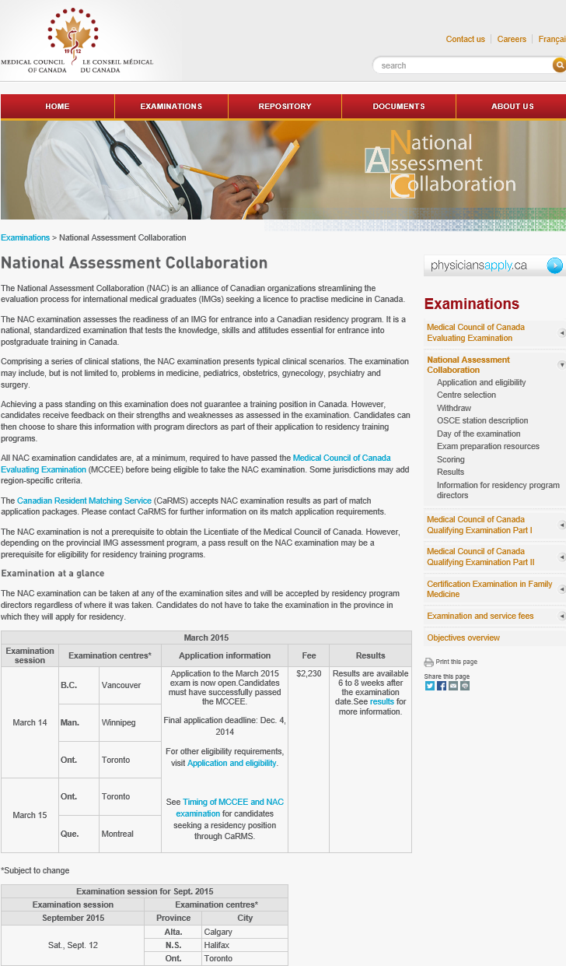
  since 2011
  assesses readiness of IMGs for entry into Canadian residency programs
    provides residency program directors with objective information on the skills, attitudes and knowledge level of applicants
  MCC and provincial IMG partners
  MCCEE is a prerequisite
  NAC required by all Canadian residency programs
Notes:
Mandatory in BC since 2011, in rest of provinces 2015

Slide 45
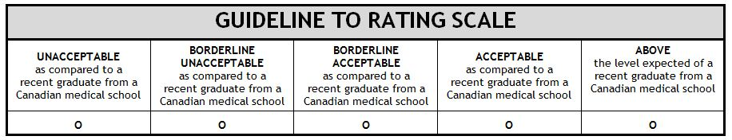
What is being assessed?
  a candidate's clinical skills, knowledge, and behaviours at a level of a recent Canadian medical graduate
  Includes, but not limited to, problems in medicine, pediatrics, obstetrics, gynecology, psychiatry and surgery
  Includes communication, language and patient-candidate interaction (professionalism - respect, appropriate consent etc.)
  Physician Examiners use a 5-point rating scale

Slide 46
Resources and Study Tips
Partner up with people who have common goals
MCC preparatory material
  MCCQE Part 1
https://mcc.ca/examinations/mccqe-part-i/preparation-resources/
  NAC OSCE: information and preparatory material:
https://mcc.ca/examinations/nac-overview/preparation-resources/
  Toronto Notes
  Canada Q Bank
  First Aid
  Study Tip: Start studying as soon as you start clinical study
  Also available: commercial courses. Vendors post on our Facebook page.
Notes:
Memorizing: Clinical Microbiology Made Ridiculously Simple teaches memorization study tricks

Slide 47
Know what is in the CaRMS Application
Applications for residency positions are all supposed to be through the CaRMS Match
Experience
Work
Scholarly Activities and Research
Volunteer
Clinical Practice
Publications/Presentations
Notes:
Good idea to list rotations and clinical experience

Slide 48
What you have to do
#4 Choose Your preferred Area of practice
  The sooner the better
  Have a look at Specialty profile: https://www.cma.ca/canadian-specialty-profiles
  Try it out—observe, volunteer, seek out a mentor, do research.
  What is the employment opportunity: rcpsc.ca—Search employment
  Look at the provincial recruiting agencies websites. (WorkForce Ontario)

Slide 49
Discipline availability for IMGs in Canada
Residency positions available in IMG stream in Canada 2018
  52.9% family medicine
  14.6% internal medicine
  7.3% psychiatry
  5.5% pediatrics
  Positions in other specialties are 2% or less.
  See reports for various years at carms.ca --Data and Reports R-1 https://www.carms.ca/data-reports/r1-data-reports/
  What is the opportunity for residency: See carms.ca Data and Reports R-1 Residency https://www.carms.ca/data-reports/?gclid=EAIaIQobChMImJP-h-vD3wIVXx-tBh3JrgwLEAAYASABEgIAbvD_BwE

Slide 50
Application period
File review
Interviews
Rank programs
Match results
Program descriptions
Found on CaRMS.ca
Information about the program
  Required documents
  Criteria for selection
  What to expect in training
  Links to additional websites
Notes:
Toutes les descriptions sont différentes.
Les descriptions inclus aussi les liens supplémentaire pour une lettre d’appui, ect.
Le système vous permet pas de postuler aux programmes toujours, c’est en section.
Faites une liste de vérification

Slide 51
What you have to do
Apply
  Canada: CaRMS USA: NRMP
  Know the criteria for selection
  Know the documents that must be submitted
  Know the timelines
  Prepare and practice for interviews
    Research and know the program
    Prepare for the “social”
    How do I apply to CaRMS if I am an IMG https://carms.zendesk.com/hc/en-us/articles/115004093363-How-do-I-apply-to-CaRMS-if-I-am-an-IMG-

Slide 52












Phases of the CaRMS match year
Application period
File review
Interviews
Rank programs
Match results
File review
Interviews
Rank programs
Match results

Slide 53
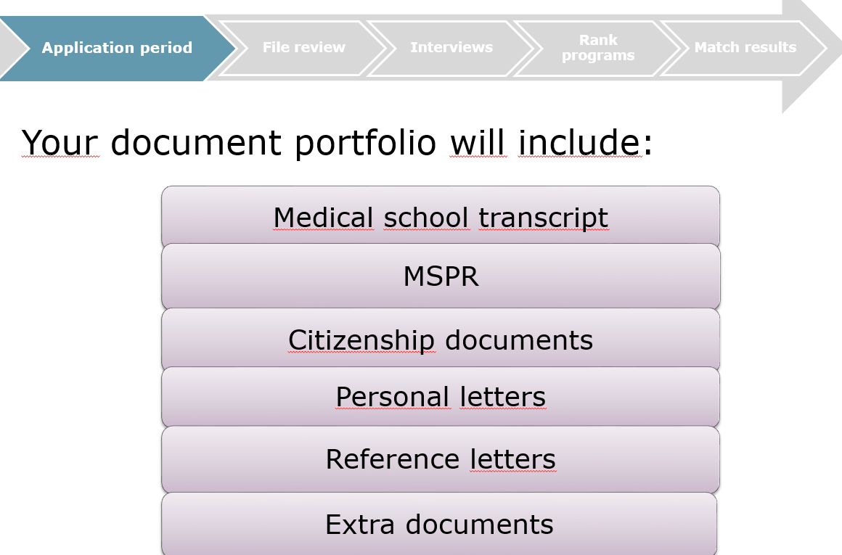
Application to CaRMS

Slide 54
What you have to do
Rank the programs
  Analyze and do risk assessment
    What you want
    Your read of who wants you

Slide 55
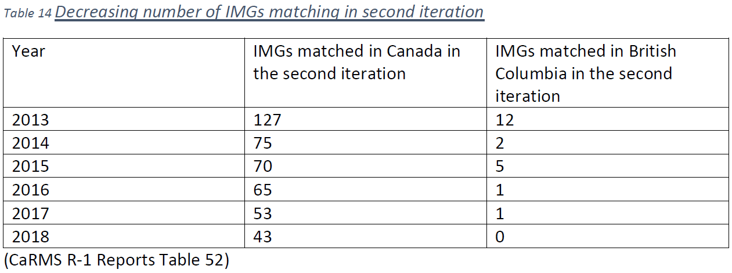
Second iteration

Slide 56
Second iteration
Chances of matching dropping each year., especially in 2nd iteration
  2013—499 IMGs matched; 2019—346 IMGs matched (CaRMS Table 1)
  2013—127 IMGs matched; 2019—43 IMGs matched in second iteration
Return of Service—For some provinces there is no ROS for matching to a position in second iteration; In Ontario must sign ROS regardless of when they match.
Risky to wait for second iteration positions.

Slide 57
Timing of Canadian and American matches
  Canada first iteration
  U.S. first iteration
  U.S. second iteration
  Canada second iteration
  Be aware that if you match in the first iteration of the Canadian Match you are automatically excluded from the US match. Similarly if you match in the first or second iteration of the US Match, you will be excluded from the second iteration of the Canadian Match.

Slide 58
American Residency Training
More than twice as many CSAs match into American residency programs than to Canadian programs (58.6% vs. 17% match rate)
Must be certified by ECFMG (FAIMER medical degree)
USMLE exams - Step 1 & 2 (CK & CS) to apply for residency
J-1 Visa - Require USMLE, Residency Match offer, Statement of Need from Health Canada + intention to return to Canada
H1B Visa - Require USMLE Step 1, 2 and 3, Residency Match offer for unsupervised practice - Note: few H1B visa available!
Dual citizenship - no visa requirement

Slide 59
Conditions of J-1 Visa
Have to leave the U.S. once residency is done.
Can get another J-1 visa if accepted into a subspecialty or fellowship program
Can get a visa waiver if a U.S. program wants to keep you - usually working in an underserviced area
Canada cannot force you to come home because you said you intended to come home.

Slide 60
STRATEGIES FOR MATCHING IN THE U.S.
PLAN!
GET HELP
STRONG PERSONAL STATEMENT – WHAT MAKES YOU DIFFERENT? WHAT MAKES YOU A GOOD FIT FOR THAT PROGRAM AND FOR THAT LOCATION? USE THE CANADIAN ADVANTAGE. BE STRATEGIC!

Slide 61
MARKS NEED TO BE IN LINE WITH SPECIALTY YOU ARE APPLYING FOR
RESEARCH DATA – MATCH DATA FOR YOUR MEDICAL SCHOOL; MATCHING DATA FOR YOUR SPECIALTY; MATCHING DATA PER STATE See: http://www.nrmp.org/
CAN IMGs APPLY? WHAT’S THE MATCH RATE FOR IMGs FOR THAT PROGRAM? (FREIDA) MOST IMG FRIENDLY SPECIALTIES: pathology, internal medicine, neurology, family medicine and general surgery
DO ELECTIVES IN PREFERED PROGRAMS AND LOCATIONS (2 OR 3) – IF REQUIRED, USE YOUR CONTACTS TO SECURE ELECTIVES - NEED GOOD REFERENCES!

Slide 62
RECOMMEND IMGs APPLY TO APPROX 150 APPLICATIONS ($$)
USE YOUR CONTACTS + CALL TO SHOW YOUR INTEREST!!!!
INTERVIEWS FOLLOWED BY THANK YOU MESSAGE
DO NOT STRETCH OUT YOUR STUDIES; DO NOT DELAY TO APPLY; DO NOT DO ANYTHING ON THE WRONG SIDE OF THE LAW
STAY HEALTHY! GOOD LUCK!

Slide 63
Alternative Careers in Healthcare
Things to consider:
Complete all relevant medical board examinations so you are prepared to apply for residency
Acceptance into a residency program may take a few years
Work in a relevant healthcare field while waiting to match
Boost your CV by attending conferences, gaining relevant experience and consider furthering your education

Slide 64
Alternative careers: Residency match
OTHER ROUTES TO PRACTICING IN CANADA
Manitoba: MLPIMG
Saskatchewan: SIPPA
Newfoundland

Slide 65
Pharmaceutical Industry
Many pharmaceutical companies hire medical doctors with or without residency
Pharmacovigilence
Drug safety
Sales
Medical Science Liaison

Slide 66
Alternative Careers: Government
Policy and management positions with the government - federal, provincial + government health agencies
Health policy within the municipal, provincial and federal level

Slide 67
Alternative careers: Technology
Digital health
Health informatics
EMR systems

Slide 68
Alternative careers: Research and Health Administration
University Health Network
University health and science departments
Hospital systems
CAMH: Centre for Addiction and Mental Health
Diabetes, Multiple Sclerosis and Trillium Health foundations

Slide 69
Alternative careers: Furthering your education
Certification programs:
Telemedicine
Wound Care
Hyperbarics

Slide 70
Alternative careers: Education
Consider obtaining a Masters degree relevant to healthcare
Masters in Public Health (MPH)
Masters of Health Administration
Masters of Business Administration
Masters of Health Informatics
Masters of Medical Sciences through Queens university: 6 month program with an option to continue into 12 months
PhD programs

Slide 71
Michener Health Institute
Bridging programs
Healthcare essentials for internationally educated health professionals
Medical Laboratory Science
Radiological Technology
Ultrasound Scanning Education
Post-Certification Programs
Anesthesia Assistant
Full Time Programs: Vary in length

Slide 72
Alternative careers: Bridging Programs
Physician assistants: 3 programs available
Nursing: Registered Nursing (RN) can lead to a nurse practitioner
Additional training required
Health Force Ontario (or equivalent agency in other provinces) should be able to guide you : http://www.healthforceontario.ca/en/Home/Health_Providers/Physicians

Slide 73
LOBBYING ELECTED OFFICIALS
FOR CHANGE
PETITION TO LEGISLATIVE ASSEMBLY
WRITE TO YOUR MPP OR MINISTER OF HEALTH (SEE SOCASMA'S TEMPLATE LETTER)
GET TO KNOW YOUR MPP : CALL, MEET, ETC.
GET FAMILY, FRIENDS AND FRIENDLY ORGANIZATIONS TO WRITE, CALL AND MEET ELECTED OFFICIALS
VOLUNTEER FOR AND SUPPORT SOCASMA (WHO IS ALSO LOBBYING COLLEGE OF PHYSICIANS, FACULTIES OF MEDICINE, FEDERAL GOVERNMENT, ETC.)

Slide 74
CONCLUSION
WE ARE HERE TO SUPPORT YOUR DREAM OF BECOMING A PHYSICIAN, MAKE SURE THE RESIDENCY RECRUITMENT SYSTEM IS FAIR, OJBECTIVE, IMPARTIAL AND TRANSPARENT, AND IMPROVE CANADIANS’ ACCESS TO HEALTH CARE
BUT TO DO THIS, WE NEED YOU TO LOBBY POLITICIANS, SUPPORT EACH OTHER, AND SUPPORT SOCASMA
WANT TO VOLUNTEER OR HAVE QUESTIONS? – GIVE US YOUR NAME, BIT OF BACKGROUND, E-MAIL AND TELEPHONE NUMBER
WANT TO FINANCIALLY SUPPORT SOCASMA?

Slide 75
STATISTICS
In the current system of access to postgraduate (residency) training:
About 1000 CSAs graduate each year;
About 1000 CSAs apply to Canada each year;
About 250 CSAs apply to Canada in the year of graduation;
Many CSAs do not apply to Canada with most Australian graduates staying in Australia to do postgraduate training and most from other countries applying to the US.
Twice as many CSAs match to residency training in the US compared to Canada.

Slide 76
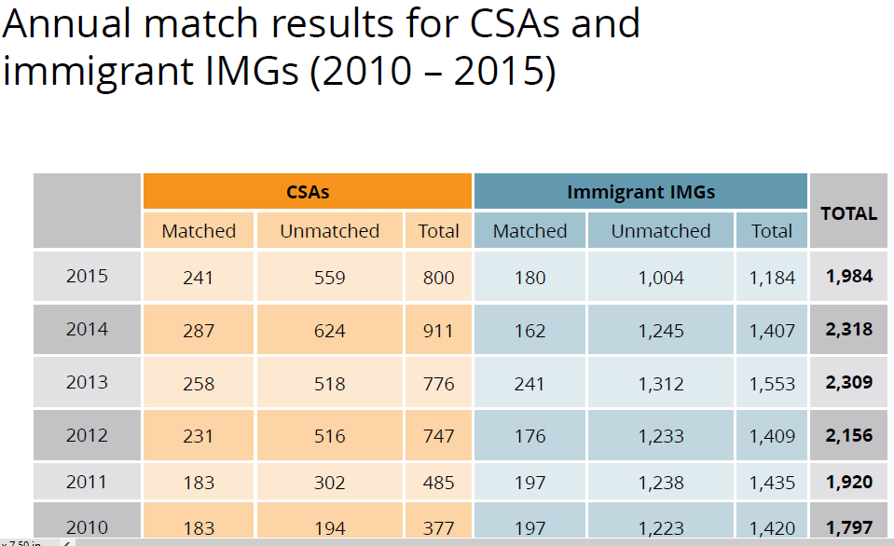
Canadian Data from CaRMS

Slide 77
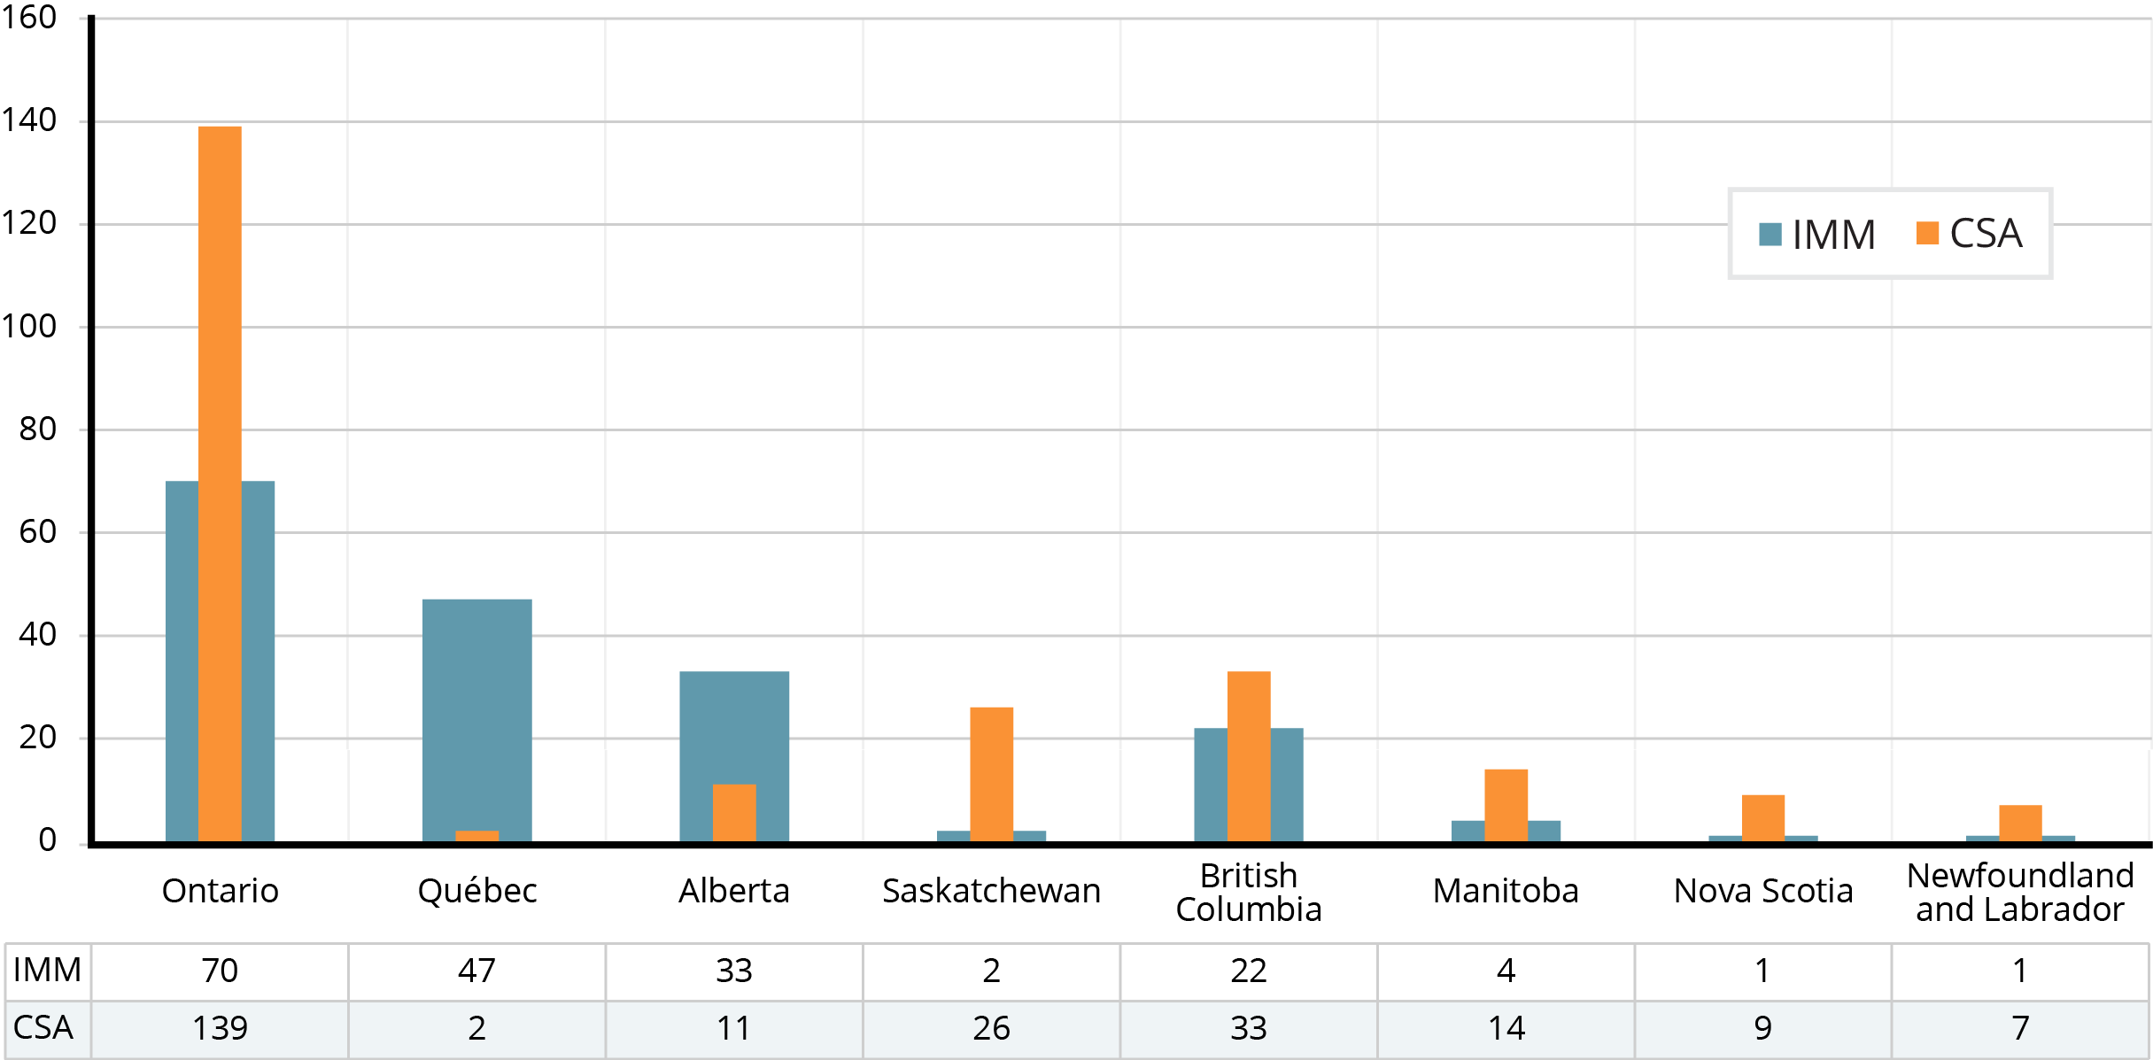
Immigrant IMGs vs. CSAs matched: provincial comparison 2015

Slide 78
Match results of Canadians studying abroad 2008-2014 R-1 match

Slide 79
Number of CSA registrants

Slide 80
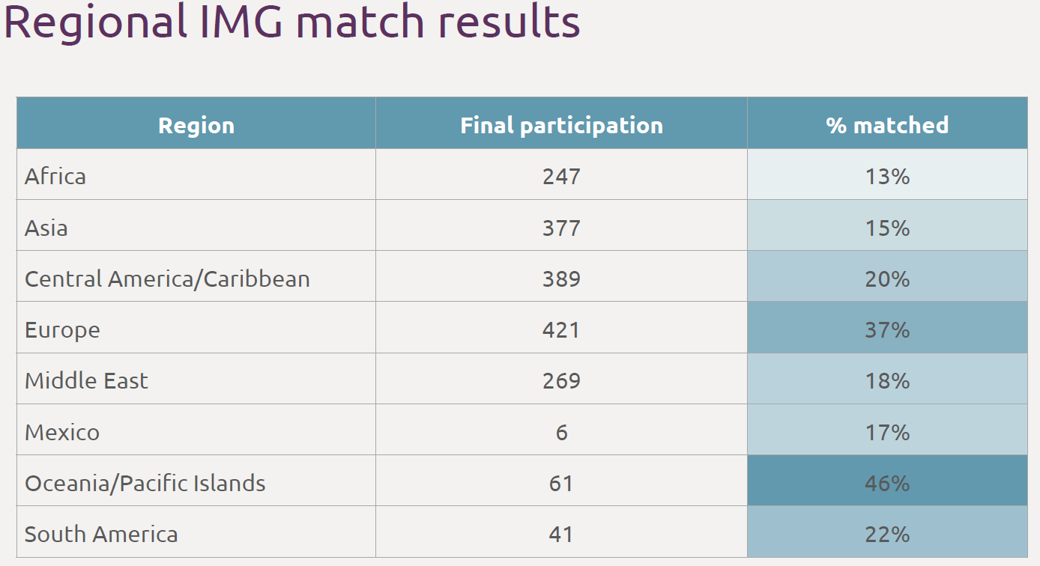
IMG matches: CSAs and immigrant physicians

Slide 81
CSAs compared to Immigrant IMGs in Canada
CSAs are a subset of IMGs.
There are statistics that differentiate between CSAs and immigrant IMGs.
September 2015 publication of the Canadian Federation of Medical Students:
  CSAs represent about 25% of the IMG applicant pool in 2011
  CSAS received more than 50% of the available IMG positions
  6% of Immigrant IMGs matched in 2011
  20.9% of CSAs matched in 2011
  These statistics are not true for British Columbia. To and including 2011, zero CSAs matched in BC in the IMG stream as far as we have been able to ascertain. There have been several CSAs who matched in the IMG stream between 2012 and 2014. BC kept CSAs out by controlling access to assessment in the year of graduation. In 2015 when the NAC OSCE for the first time became readily available across Canada so CSAs had access to assessment, 33 out of 55 IMGs who obtained positions in BC were CSAs.

